Slide 1

        A
        Project Report
        On
        Language Translator
        Developed by
    Shivani Bathani(IT-05) - Department of IT, DD University
    Shyam Bhadeshiya(IT-06) - Department of IT, DD University
    Internal Guide:
    Prof. Roshni M. Raval
    Department of Information Technology
    Faculty of Technology
    DD University
      Department of Information Technology
      Faculty of Technology, Dharmsinh Desai University
      College Road, Nadiad-387001
      May – 2020-21

Slide 2
Language description/feature:
In this project we made a compiler of our language that provides
String operations like:
concat(var A , var B) : Concatenation of string present in B with that in A .
search(var A, char o) : In this function we search for character ‘o’ in string stored in var A.
replace(var A, char b, char w): Here we replace character ‘b’with another character ‘w’ in string stored in
        Variable A.
valueAt(var A, int pos) : This function shows the character at given position in the string stored in A.
copy(var A, var B) : In copy function we copy string stored in one variable into another variable.

Slide 3
The constraints in this language are:
The name of the variable must be single upper-case alphabet i.e. var A,B;
The beginning of the string must be capital letter i.e. var A = Hello;
This language strictly deals with string (character array) it does not allow to store integer values in the variable i.e. var A = 1; is not possible.

Slide 4
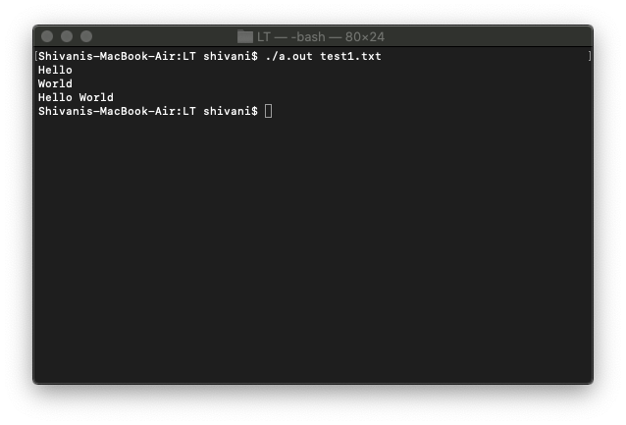
Concate function:
    start@
    var A,B;
    A=Hello;
    B=World;
    show(A);
    show(B);
    var C;
    C=concat(A,B);
    show(C);
    @end

Slide 5
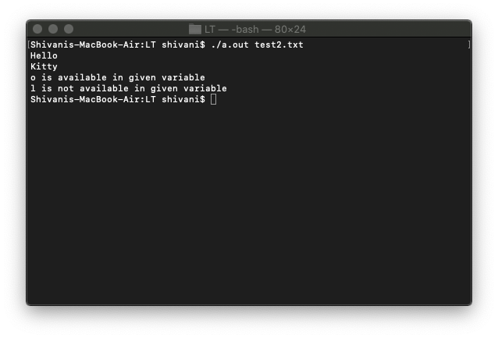
Search Function:
    start@
    var A,B;
    A=Hello;
    B=Kitty;
    show(A);
    show(B);
    search(A,o);
    search(B,l);
    @end

Slide 6
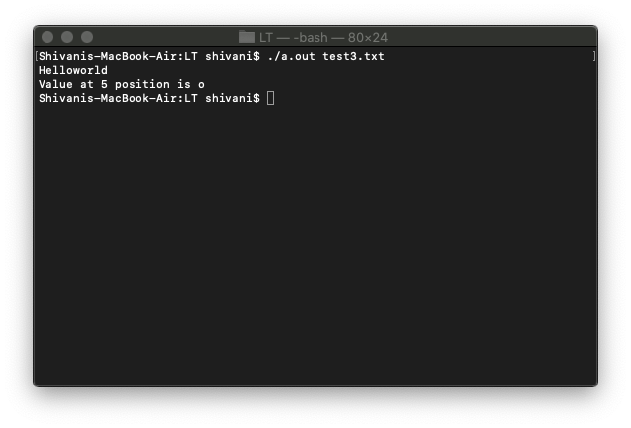
ValueAt Function:
    start@
    var A;
    A=Helloworld;
    show(A);
    valueAt(A,5);
    @end

Slide 7
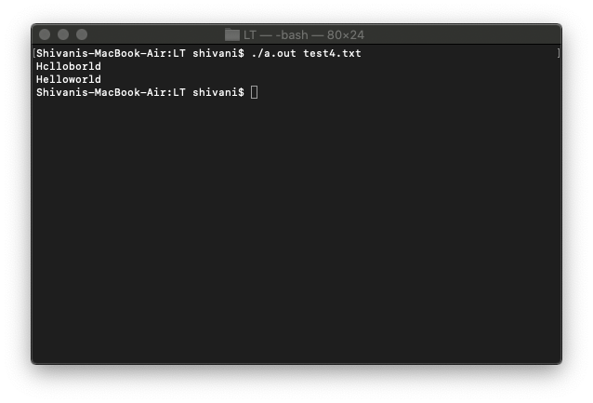
Replace Function:
    start@
    var A;
    A=Hclloborld;
    show(A);
    replace(A,c,e);
    replace(A,b,w);
    show(A);
    @end

Slide 8
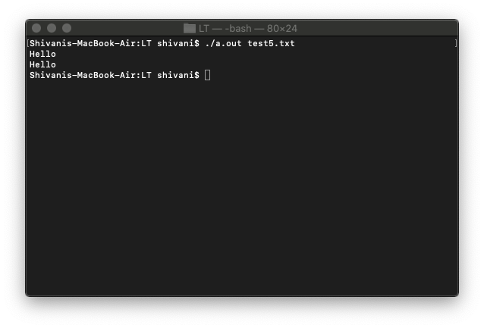
Copy Function:
    start@
    var A,B;
    A=Hello;
    show(A);
    copy(A,B);
    show(B);
    @end

Slide 9
All the files of our project have been uploaded on the following GitHub link:
https://github.com/shivanibathani/Myprojects/tree/master/LT

